Slide 1

遊戲範例

Slide 2
Outline
Qt Introduction
Download Qt
New Qt Project
How to start your first Qt project

Slide 3
What is Qt?
Qt（官方發音同cute )，是一個跨平台的C++應用程式開發框架，廣泛用於開發GUI(使用者介面圖形)程式。
Qt擁有完善的C++圖形函式庫。
支援多種平台。會自動依平台的不同，表現平台特有的圖形介面風格。
目前最新版本為5.4

Slide 4
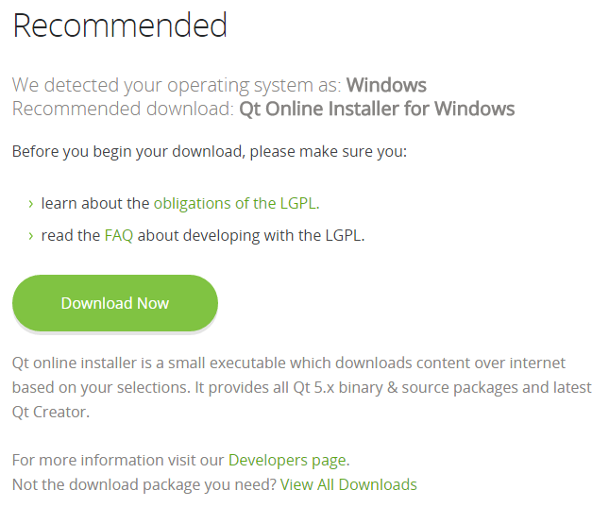
Download Qt
Download Link: http://www.qt.io/download-open-source/

Slide 5
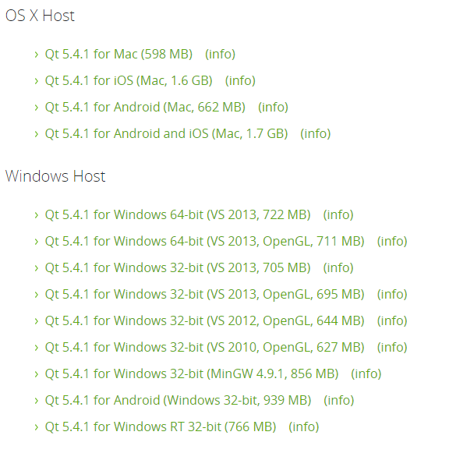
Download Qt

Slide 6
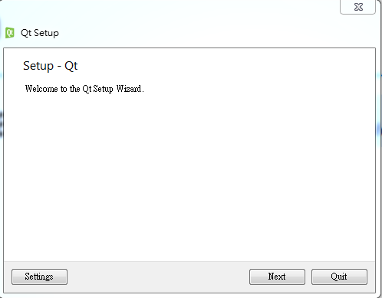
Download Qt

Slide 7
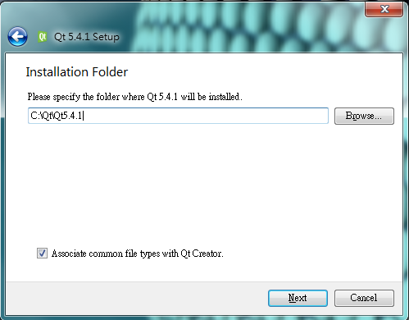
Download Qt

Slide 8
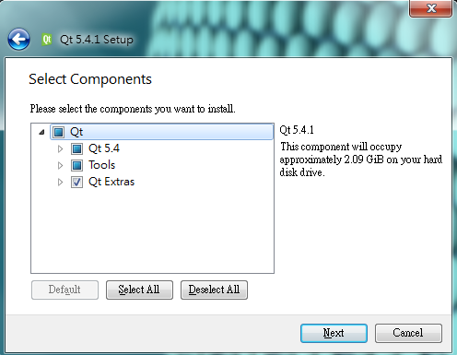
Download Qt

Slide 9
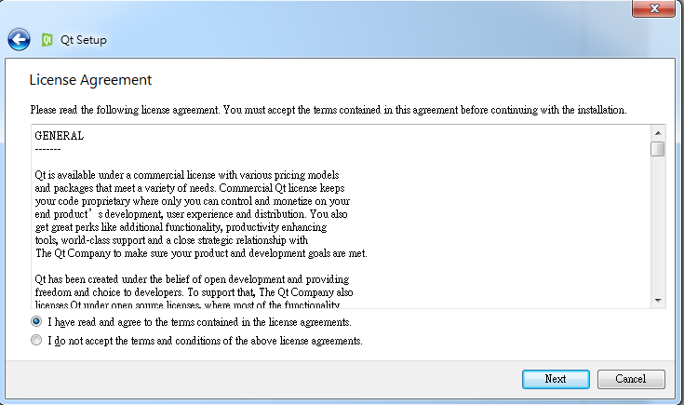
Download Qt

Slide 10
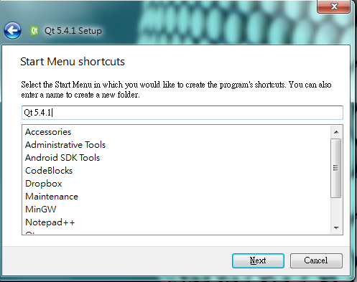
Download Qt

Slide 11
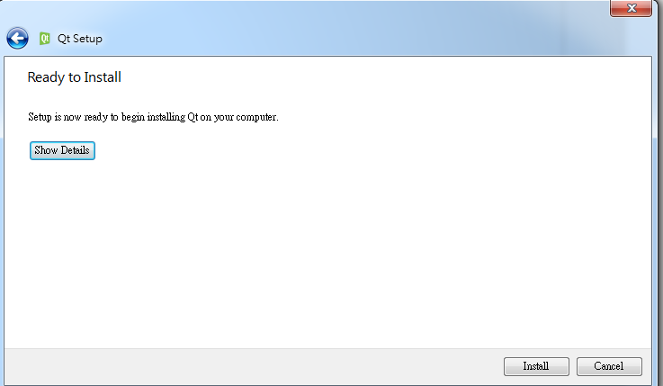
Download Qt

Slide 12
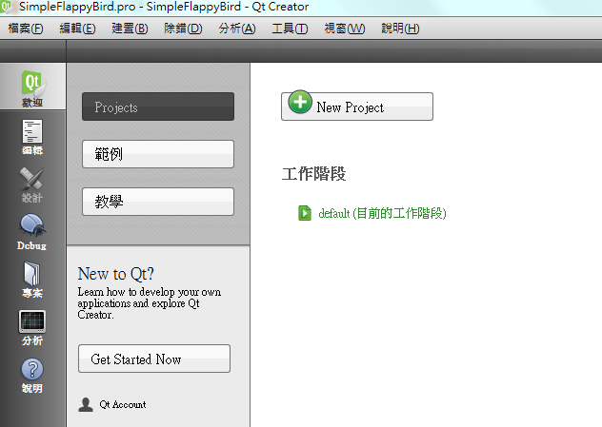
New Qt Project
New Project

Slide 13
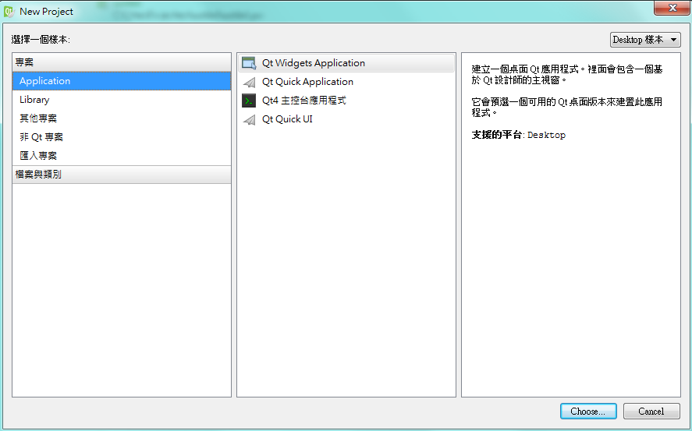
New Qt Project
Qt Widgets
Application

Slide 14
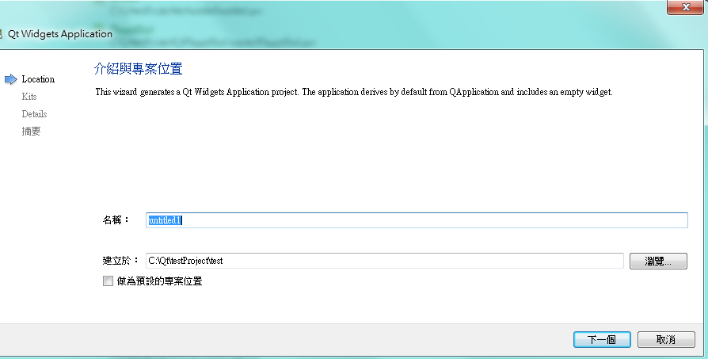
New Qt Project
輸入專案名稱
選擇專案路徑,路徑不能有中文名稱

Slide 15
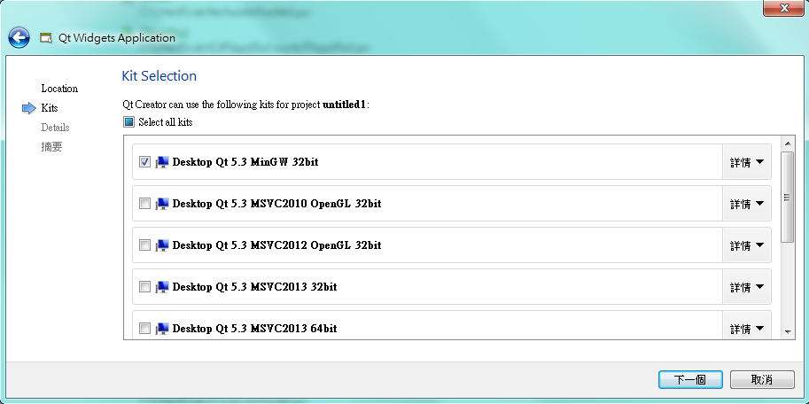
New Qt Project
Choose
kits
Notes:
選擇適當的配件

Slide 16
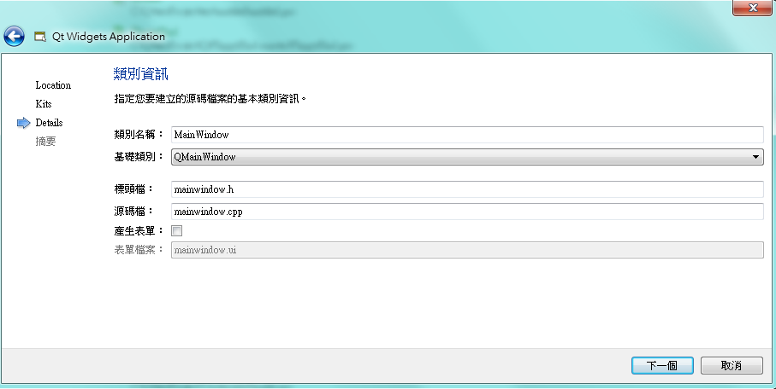
New Qt Project
取消 “產生
表單” 選項
這次專案不會用到

Slide 17
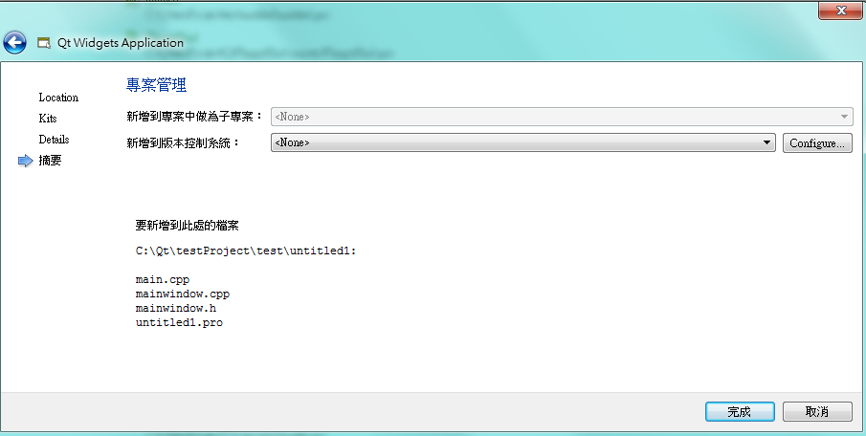
New Qt Project
新增完畢

Slide 18
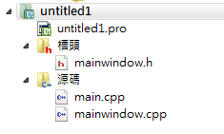
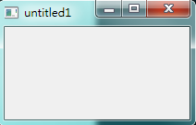
New Qt Project done
新增完成之後，如右圖
xxx.pro
mainwindow.h
main.cpp
mainwindow.cpp
直接執行此專案結果如右圖

Slide 19
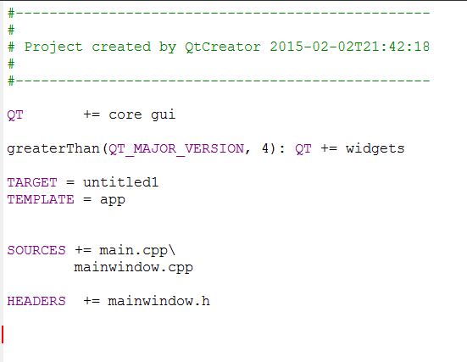
Qt project file
Project file 包含建置此project 所需要的資訊。

Slide 20
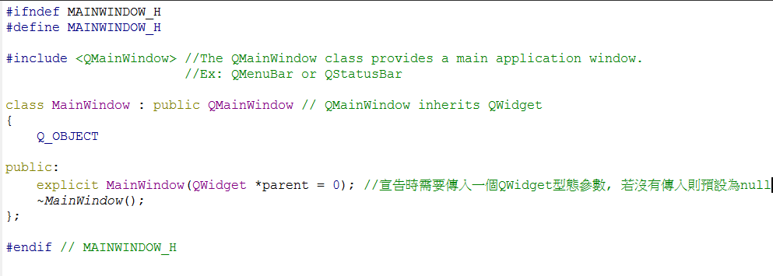
Overview to mainwindow.h

Slide 21
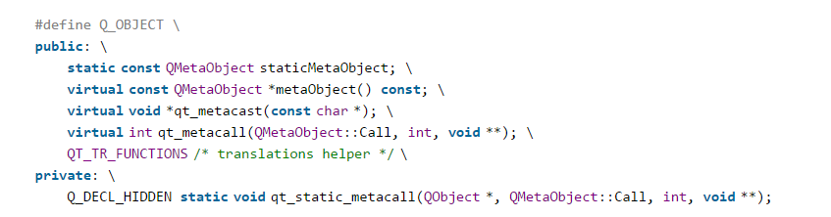
What is Q_OBJECT?
http://woboq.com/blog/how-qt-signals-slots-work.html
Notes:
她是一段巨集, 展開來大概長這個樣子, 她是整個Qt物件最基礎的類別, 日後如果有需要宣告一些特別的變數就必須先打上這一行
The QObject class is the base class of all Qt objects

Slide 22
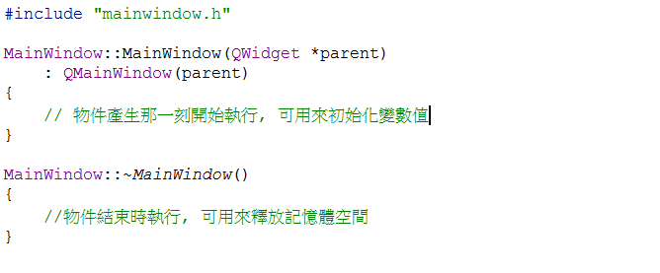
Overview to mainwindow.cpp

Slide 23
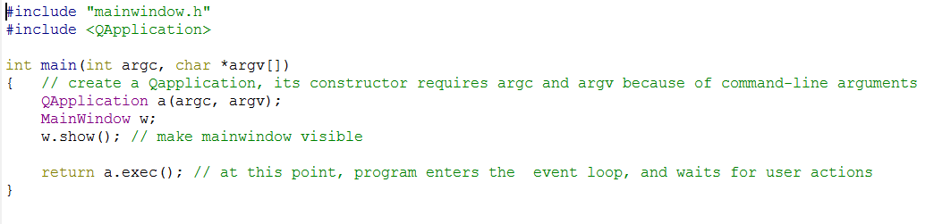
Overview to main.cpp
Notes:
基本上這個main.cpp不會更改到

Slide 24
Start to design your own project
Image and Animation
Keyboard Control
Mouse Control
Play Music

Slide 25
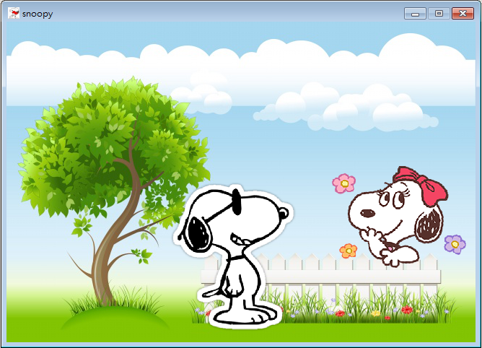
Example

Slide 26

How to draw background?
If you want to use images, you need to new a resource file.

Slide 27
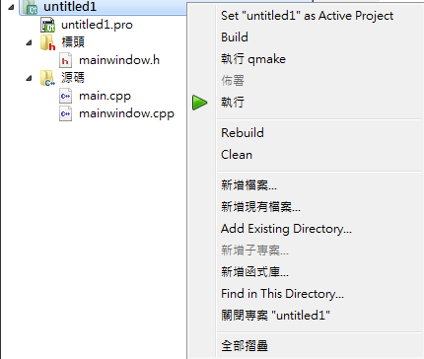
New Qt resource file
右鍵

Slide 28
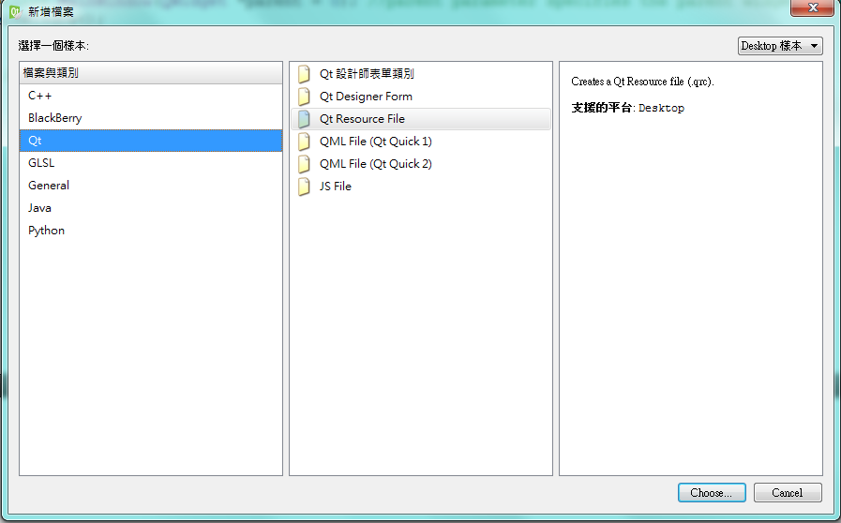
New Qt resource file

Slide 29
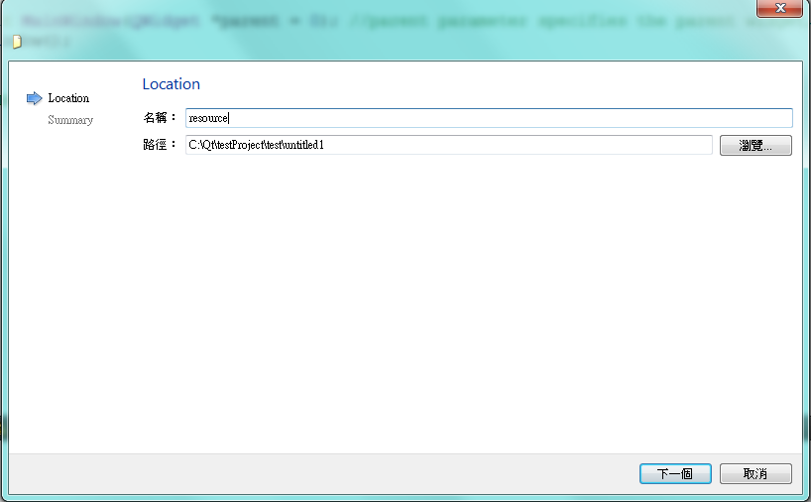
New Qt resource file
輸入名稱

Slide 30
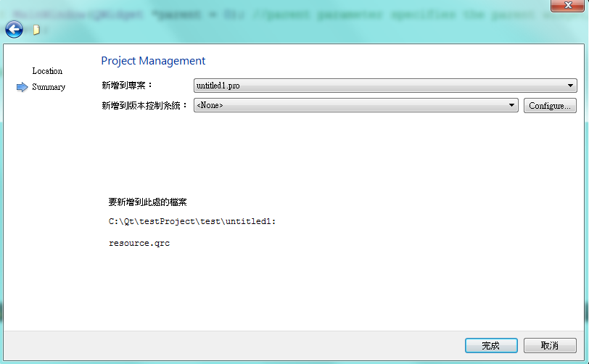
New Qt resource file done

Slide 31
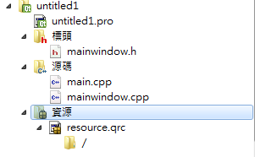
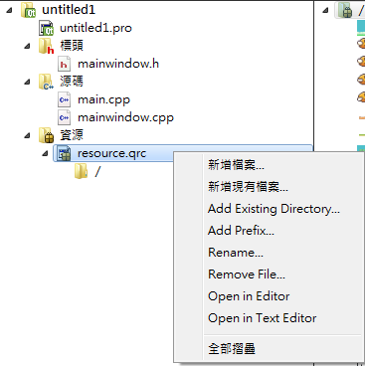
New resource
新增完成之後會多一個 .qrc file
若程式需要新增資源(圖片)，可利用 .qrc file點右鍵新增
右鍵

Slide 32
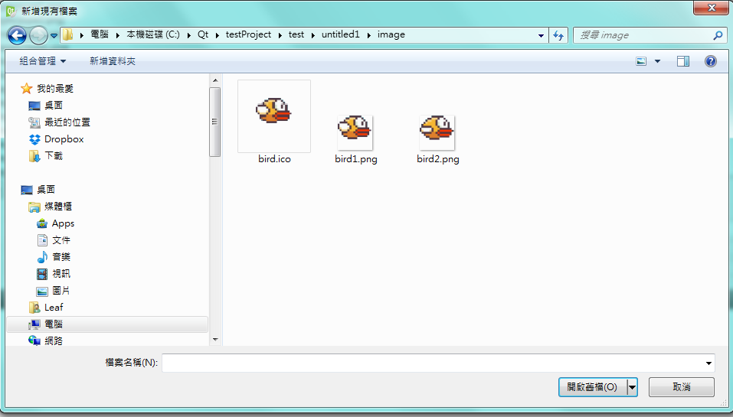
New resource
選擇要新增的圖檔

Slide 33
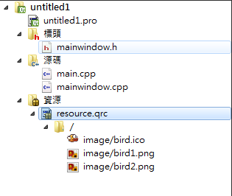
New resource done
新增成功之後如右圖

Slide 34

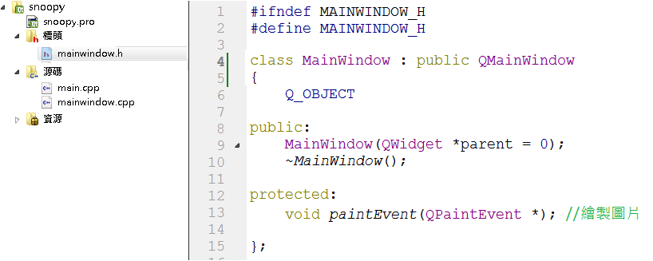
How to draw background?
Function declaration in mainwindow.h

Slide 35
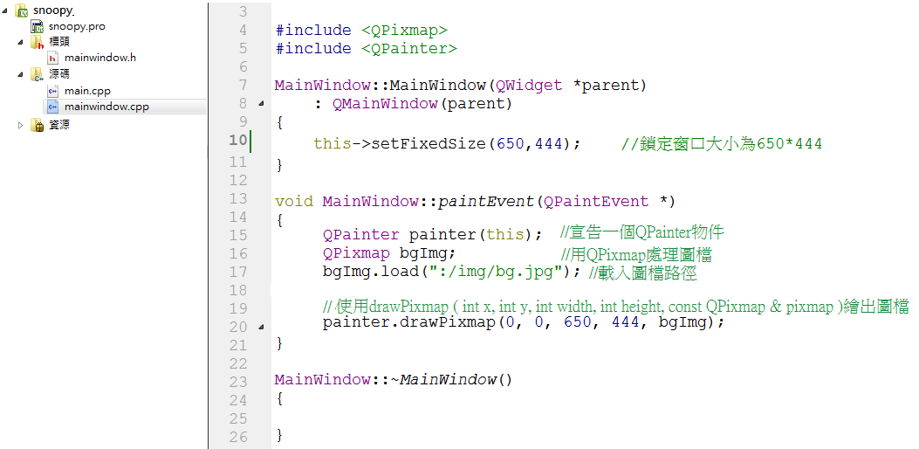
How to draw background?
Implement the functions in mainwindow.cpp
Include QPixmap、QPainter class in mainwindow.cpp

Slide 36
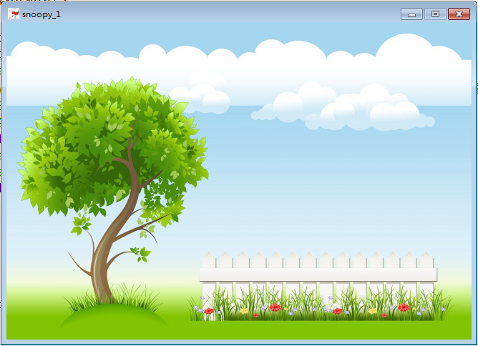
How to draw background?
Show result in application window.
650
(0,0)
444

Slide 37
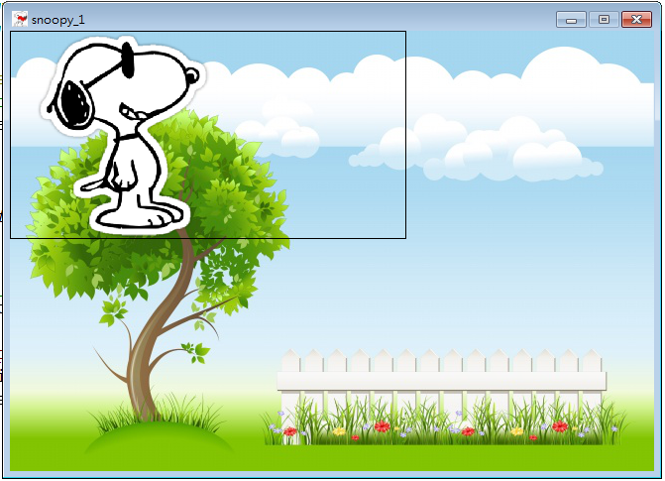
How to draw Snoopy?
You should create a “Snoopy” class first.

Slide 38
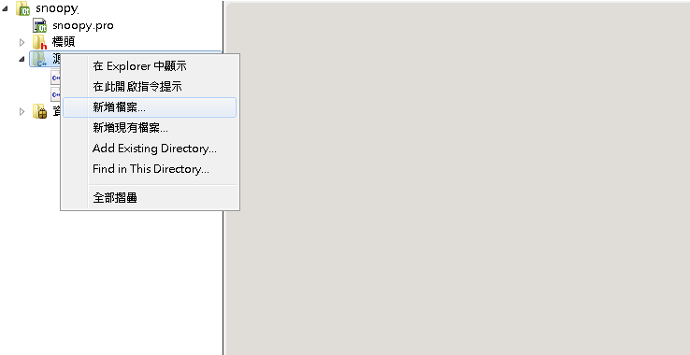
How to create a class in Qt?

Slide 39
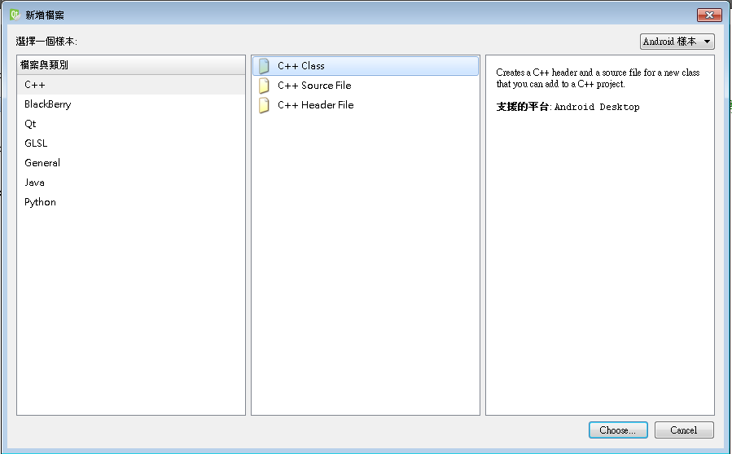
How to create a class in Qt?

Slide 40
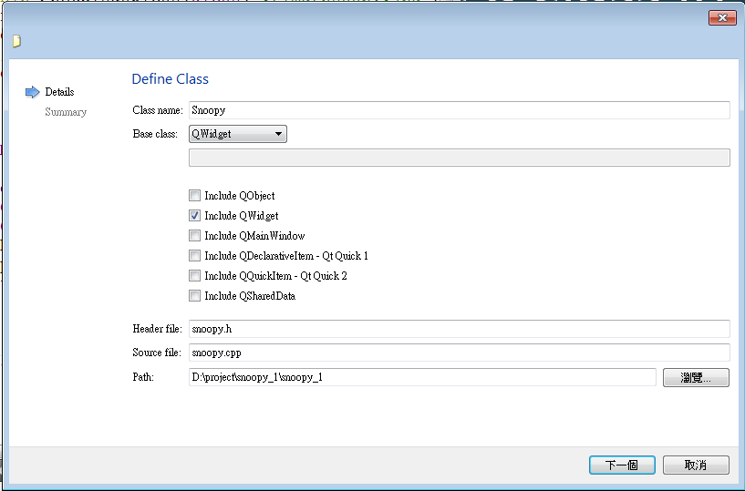
How to create a class in Qt?
Choose QWidget class to inherit it.

Slide 41
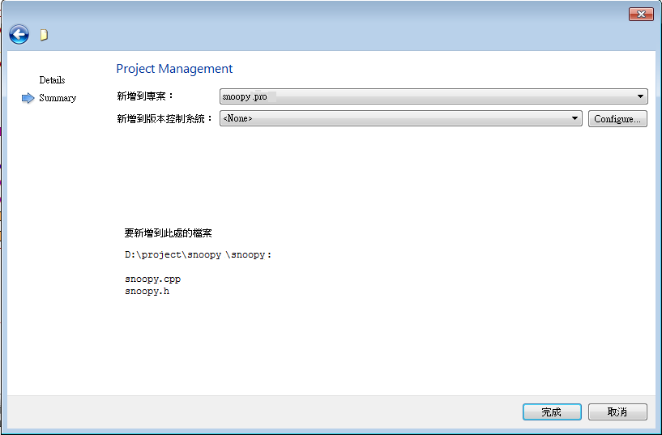
How to create a class in Qt?

Slide 42
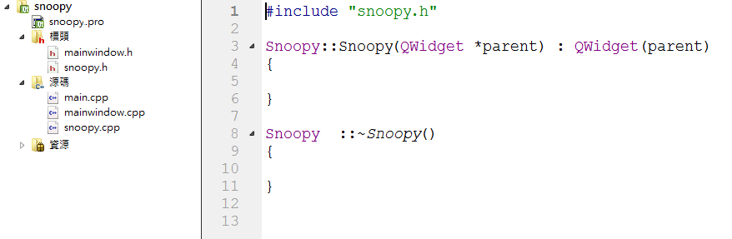
How to create a class in Qt?
Initial appearance in new class.cpp.
Notes:
這邊可以提到一下 snoopy 是繼承於QWidget的類別

Slide 43
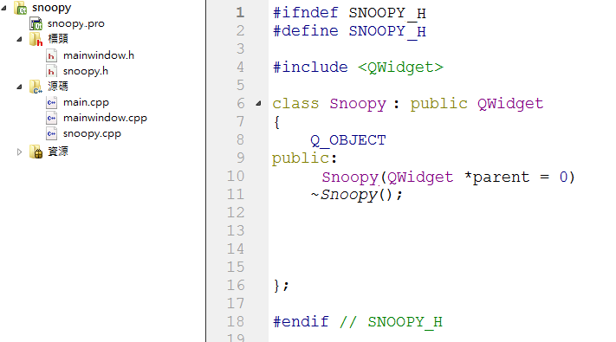
How to create a class in Qt?
Initial appearance in new class.h.

Slide 44

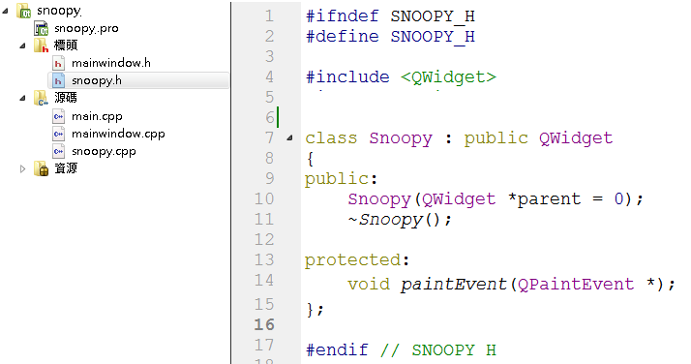
How to draw Snoopy?
Function declaration in snoopy.h

Slide 45
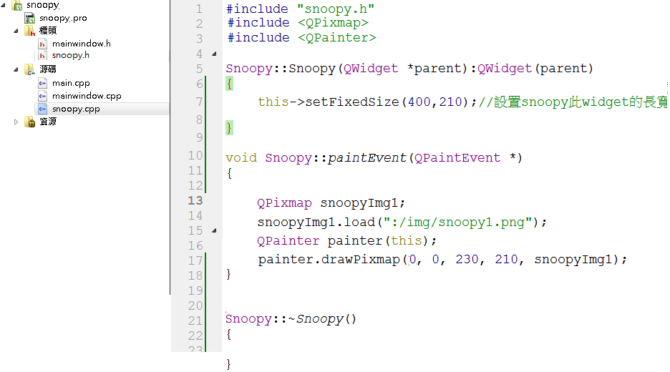
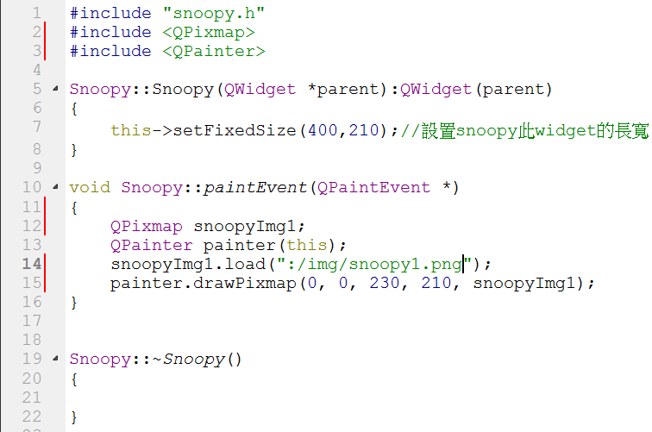
How to draw Snoopy?
Implement the functions in snoopy.cpp
Include QPixmap、QPainter class in snoopy.cpp
(0,0)
400
230
210
210

Slide 46
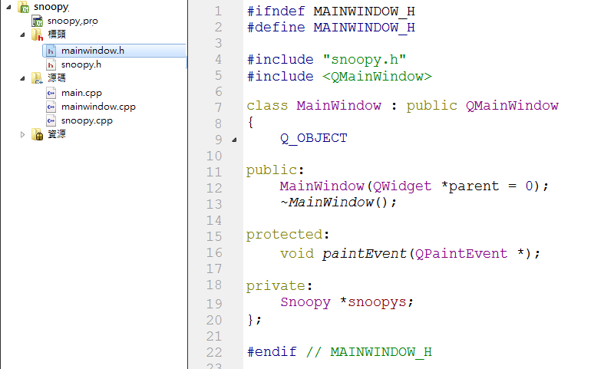
How to draw Snoopy?
Include snoopy.h in mainwindow.h.
Declare a Snoopy type pointer.

Slide 47
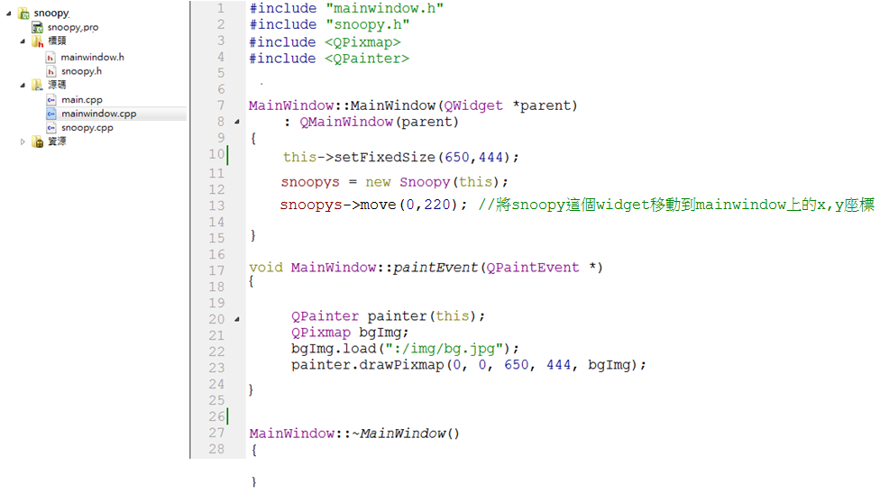
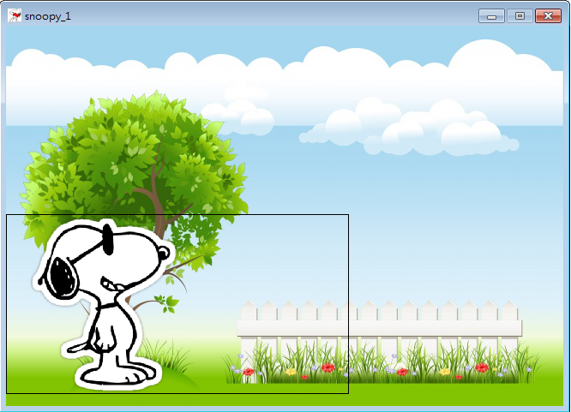
How to draw Snoopy?
New a snoopy object in mainwindow.cpp.
Move the snoopy widget to where you want to put in main window.
(0,220)
Notes:
這邊可以強調一下 move不用實作, 她是繼承Qwidget就會有的功能

Slide 48

How to draw a “moving” Snoopy?
To repaint window view so that Snoopy looks like really moving!
We will use QTimer class to realize it~

Slide 49
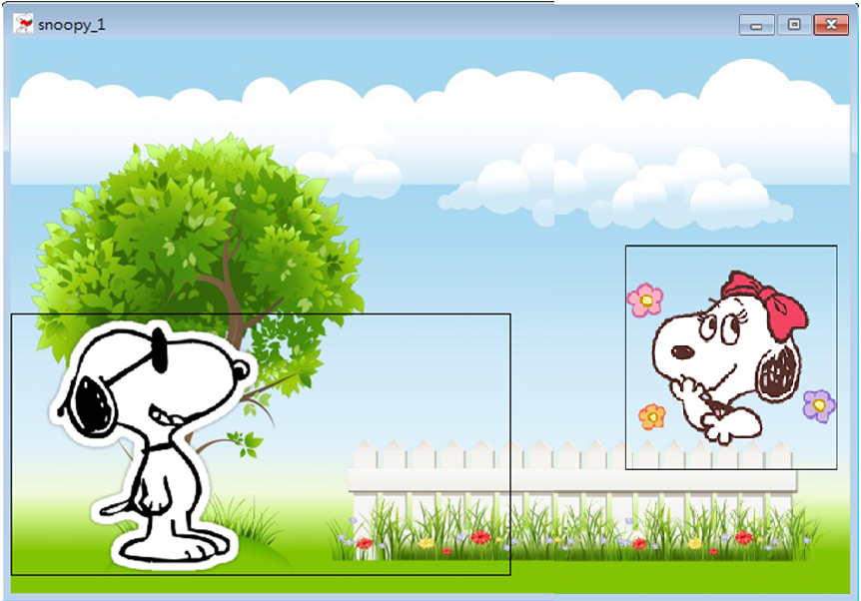
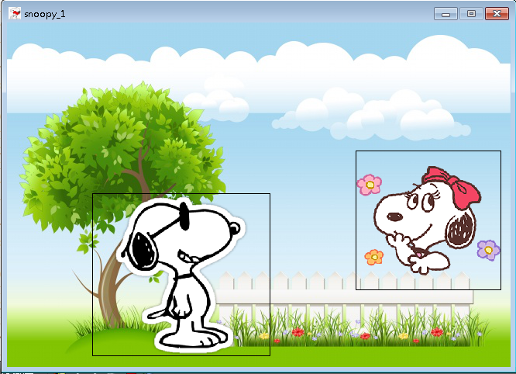
How to draw a “moving” Snoopy?
way1:
change image position in a fixed size widget.
way2:
move whole widget in the main window.

Slide 50
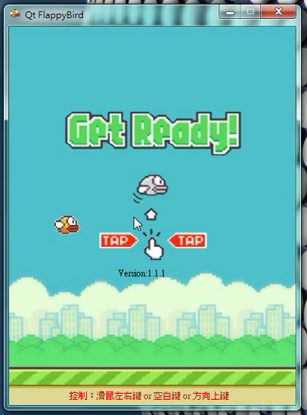
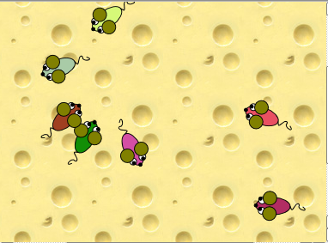
way1 v.s way2
way1 is better
way2 is better

Slide 51

How to draw a “moving” Snoopy? way1: change image position in a fixed size widget

Slide 52

How to draw a “moving” Snoopy? way1: change image position in a fixed size widget
1.1
Include QTimer in snoopy.h.
Declare related variation.

Slide 53


How to draw a “moving” Snoopy? way1: change image position in a fixed size widget
1.2
Use connect function to connect timer object and snoopy object.
When timer emits timeout signal, use update() function let paintEvent be triggered.
In this example, we let paintEvent be executed every second.
Notes:
update()是在Qwidget底下的member function

Slide 54


How to draw a “moving” Snoopy? way1:change image position in a fixed size widget
1.3
Implement the paintEvent functions in snoopy.cpp.
Change image’s x axis position in snoopy widget.
_
_
_

Slide 55

How to draw a “moving” Snoopy? way2: move whole widget in the main window

Slide 56


How to draw a “moving” Snoopy? way2: move whole widget in the main window
2.1

Slide 57

How to draw a “moving” Snoopy? way2: move whole widget in the main window
2.2
Implement the paintEvent functions in snoopy.cpp.
Set fixed image position in snoopy widget.
測試用

Slide 58

How to draw a “moving” Snoopy? way2: move whole widget in the main window
2.3
Declare a slots function in mainwindow.cpp.
Declare a timer.

Slide 59

How to draw a “moving” Snoopy? way2: move whole widget in the main window
2.4
When timer emits timeout signal, let snoopyAction() function be executed.
In this example, we let snoopyAction() be executed every second.

Slide 60

How to draw a “moving” Snoopy? way2: move whole widget in the main window
2.5
Implement snoopyAction() functions in mainwindow.cpp.
Use move(x,y) function to move widget in main window.
Move function will trigger paintEvent.

Slide 61
Qt- about key and mouse events

Slide 62
How to implement?

Slide 63


Event handler-key
Click up button

Slide 64

First Step
Function declaration in mainwindow.h

Slide 65

Second Step
Include QKeyEvent class in mainwindow.cpp

Slide 66

Third Step
Implement the functions in mainwindow.cpp

Slide 67

Event handler-key
Void keyPressEvent ( QKeyEvent * event )
This event handler, for event event, can be reimplemented in a subclass to receive key press events for the widget.
int QKeyEvent::​key() const
Returns the code of the key (Qt::​Key) that was pressed or released.

Slide 68

Event handler-mouse
void mousePressEvent ( QMouseEvent * event )
This event handler, for event event, can be reimplemented in a subclass to receive mouse press events for the widget.
Qt:MouseButton QMouseEvent::button () :const
Returns the button that caused the event.(Qt::MouseButton)

Slide 69
How to play music?

Slide 70

How to play music?
點下左鍵撥放背景音樂
點下右鍵撥放音效

Slide 71

.pro file

Slide 72

Add file into project

Slide 73

Add file into project

Slide 74

Add file into project

Slide 75

How to use in yourclass.h file?
新增這一行
新增這兩行

Slide 76



How to use In yourclass.cpp file?

Slide 77


How to use In yourclass.cpp file?

Slide 78




easyMusic.h

Slide 79



easyMusic.cpp

Slide 80
Reference
QMediaPlayer Class
http://doc.qt.io/qt-5/qmediaplayer.html

Slide 81
Additional Information

Slide 82

What is widget?
一般的GUI 中我們常會聽到 ”widget ”這個名詞
What is a widget?
Widget簡單的來說就是實用小工具，提供使用者一個簡易的介面去執行一些常常用的功能。
Qt內部有提供使用者介面設計的基礎類別 QWidget。Qt中所有類型的GUI組件如按鈕、標籤、工具列等都是繼承QWidget這個類別而來。

Slide 83
What are events in Qt?
Events are generated by the window system or by Qt itself in response to various occurrences.
Example 1. When a window is shown for the first time, a paint event is generated to tell the newly visible window that it needs to draw itself.
Example 2. When the user presses or releases a key or mouse button, a key or mouse event is generated.

Slide 84
Qt class

Slide 85
QObject class
QObject is the heart of the Qt Object Model.
The central feature in Qt Object Model is a very powerful mechanism for object communication called signals and slots.
You can connect a signal to a slot with connect() function in QObject.
Reference: http://qt-project.org/doc/qt-4.8/qobject.html#details
connect(sender, SIGNAL(signal), receiver, SLOT(slot));

Slide 86

Connect function under QObject class
A signal is emitted when a particular event occurs. Qt's widgets have many predefined signals, but we can always subclass widgets to add our own signals to them.
A slot is a function that is called in response to a particular signal. Qt's widgets have many pre-defined slots, but it is common practice to subclass widgets and add your own slots so that you can handle the signals that you are interested in.

Slide 87
QWidget class
The QWidget class is the base class of all user interface objects.
Qt GUI components in all types such as button, label, toolbar are derived from QWidget.
Every widget is rectangular.
It receives mouse, keyboard and other events from the window system, and paints a representation of itself on the screen.
QWidget *parent = 0 is the parent of the new widget. If it is 0 (the default), the new widget will be a window. If not, it will be a child of parent.
Reference: http://qt-project.org/doc/qt-4.8/qwidget.html

Slide 88


Public Functions in QWidget class (common use)
void setFixedSize ( int w, int h )
void move ( int x, int y )
void setWindowIcon ( const QIcon & icon )
……
29 public functions inherited from QObject
13 public functions inherited from QPaintDevice

Slide 89
Public Slots in QWidget class (common use)
bool close () //Closes this widget.
void update () //Updates the widget unless updates are disabled or
the widget is hidden.
void show () //Shows the widget and its child widgets.
……
Notes:
update () 和 repaint ()差別??

Slide 90
Protected Functions in QWidget class (common use)
Common use
virtual void paintEvent ( QPaintEvent * event )
virtual void keyPressEvent ( QKeyEvent * event )
virtual void mousePressEvent ( QMouseEvent * event )
Others
virtual void keyReleaseEvent ( QKeyEvent * event )
virtual void mouseReleaseEvent ( QMouseEvent * event )
virtual void mouseMoveEvent ( QMouseEvent * event )
......

Slide 91
QMainWindow class
A main window provides a framework for building an application's user interface.
QMainWindow has its own layout to which you can add QToolBars, QDockWidgets, a QMenuBar, and a QStatusBar.
The layout has a center area that can be occupied by any kind of widget.
Most applications use a QMainWindow or a QDialog as the application window, but Qt is so flexible that any widget can be a window.
Reference: http://qtproject.org/doc/qt4.8/qmainwindow.html#details

Slide 92

QMainWindow class

Slide 93
Public Functions in QMainWindow class (common use)
QMenuBar * menuBar () const
QToolBar * addToolBar ( const QString & title )
void addDockWidget ( Qt::DockWidgetArea area, QDockWidget * dockwidget )
QStatusBar * statusBar () const
221 public functions inherited from QWidget
29 public functions inherited from QObject
13 public functions inherited from QPaintDevice

Slide 94




Slide 95



Slide 96




Slide 97



Slide 98
END

